Slide 1
Patient Study Calendar (PSC)
2.6
PSC Data System Overview
So, the short version is time is an extremely valuable commodity to patients, nearly more valuable than gold.
– Virginia Hetrick, patient advocate
Northwestern University
November, 2009

Slide 2
Goal of presentation
  The goal of this presentation is to introduce the data system and design of the Patient Study Calendar (PSC) to members of the caBIGTM community who will be conducting the Silver Level Compatibility review for PSC
  The first sections of this presentation are unchanged from the previous Silver Level review of PSC 2.1. The final section shows some of the additions to the model between 2.1 and 2.6.

Slide 3
PSC basics
The features of PSC generally support three basic functions:
  Create a template to represent the activities of a study protocol
  Assign the appropriate parts of the template to a subject with start dates to generate a calendar
  Manage changes to the schedule and state of activities as the subject progresses through the study

Slide 4
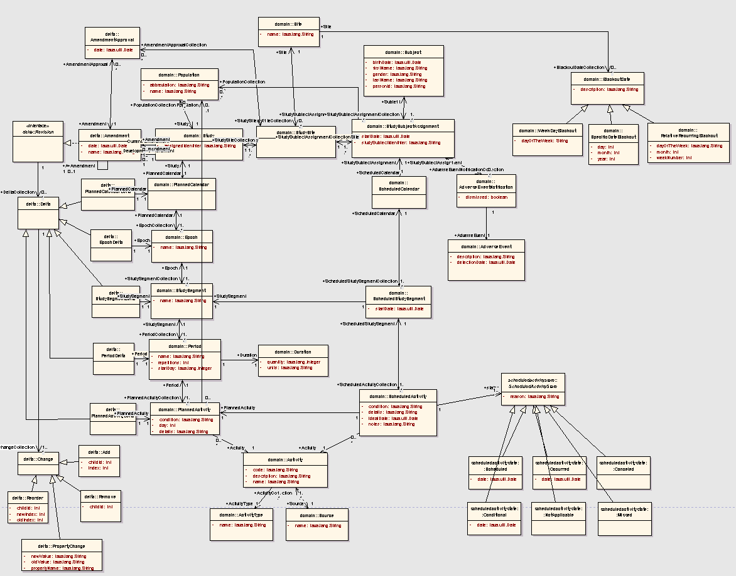
Data model

Slide 5
PSC model walkthrough
We will examine the model in logical sections:
  Planned
  Amendments
  Scheduled
  General clinical trials classes
  New concepts in 2.6

Slide 6
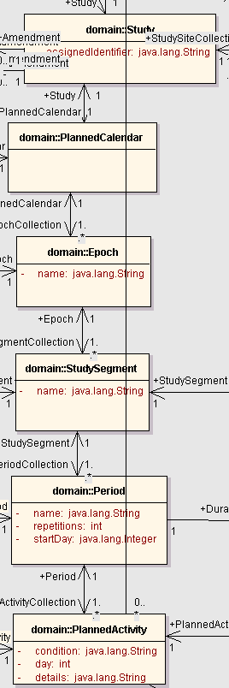
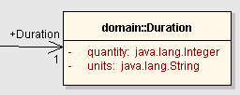
PSC Planned
For each study, a PlannedCalendar (called a “template” in the UI) is created.
A PlannedCalendar has one or more Epochs, which contain one or more StudySegments.
StudySegments have periods, which define time in collections of days that may repeat
PlannedActivities are activities which have been assigned to happen on a day within a period

Slide 7
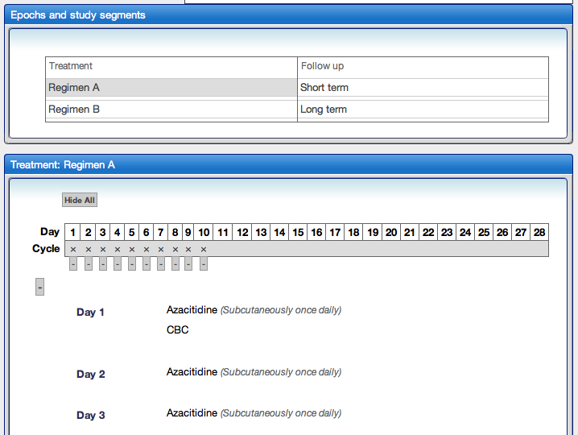
PSC Planned in the UI
Here the Treatment and Follow up epochs each have two study segments.
The study segment Regimen A is showing in the details box. It has a 28-day period (here named “Cycle”) with activities on the first 10 days.

Slide 8
PSC Planned Origin
Classes are based upon BRIDG 1.1.
Epoch comes directly from TDM.
StudySegment appears in BRIDG and is closely related to TDM’s Element.

Slide 9
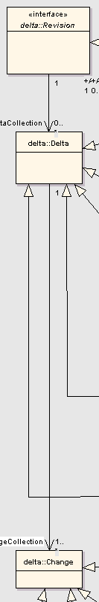
PSC Amendments
Support of protocol amendments a major goal and challenge for PSC Phase 2
An amendment is a type of Revision. (It’s the only type that we currently support.)
Each Revision is a collection of Deltas.
Each Delta is a collection of Changes.
Confused yet? We’ll start at the smallest level and work our way up.

Slide 10
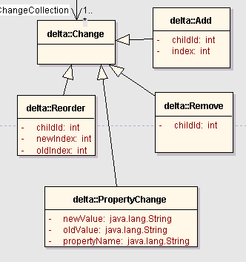
PSC Amendments – Ch-ch-changes
We have a specialization for every type of change that can occur to a node (object) within a PlannedCalendar.
Note that Add, Remove, and Reorder actually occur to the child node*. In other words, removing a StudySegment is a change to an Epoch. Adding an Epoch is a change to the PlannedCalendar.
PropertyChange changes occur to the specified node (for example, changing the number of days of a period).
All of the changes to a particular node are collected in a Delta, as depicted on the next slide.
*The chain of parent to child nodes is: PlannedCalendar->Epoch->StudySegment->Period->PlannedActivity

Slide 11
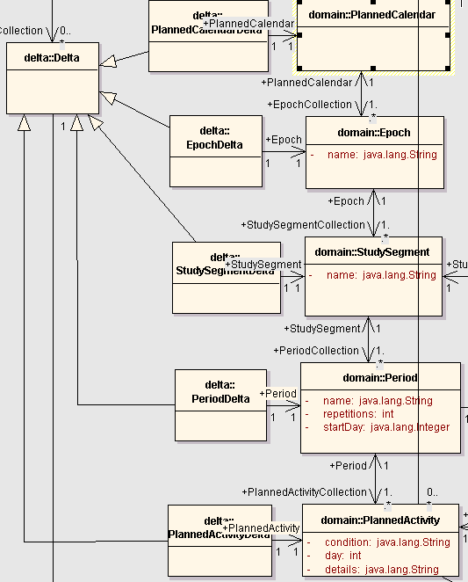
PSC Amendments – Deltas
We have a specialization of Delta for each node of the PlannedCalendar.
Each instance of a Delta is a collection of changes to a particular node.
We’ll now look at the top level.

Slide 12
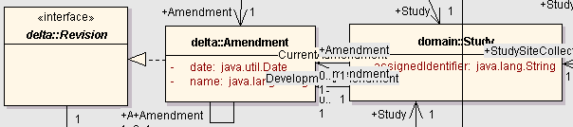
PSC Amendments – Revisions
A Revision collects all of the changes to the various nodes of the PlannedCalendar.
At this time, we only support one type of Revision – Amendment. However, we are considering supporting a type called a “Correction” as a different type.
It may not be perfectly clear from this diagram, but we support having both a “Current” Amendment and a “Development” Amendment at any given time. In other words, one amendment may be in effect while another is being created.
At this time, Amendments must be applied sequentially. Doing otherwise would be tremendously complicated.

Slide 13
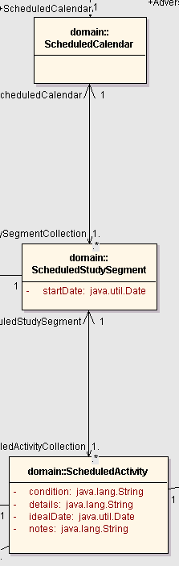
PSC Scheduled
When a subject is enrolled in the study, a StudySegment is given a start date creating a ScheduledStudySegment.
The ScheduledStudySegment generates ScheduledActivities from the PlannedActivities of the corresponding StudySegment.
The ScheduledCalendar is the collection of all ScheduledStudySegments.
ScheduledActivities are the most important objects in PSC.
Let’s take a closer look at ScheduledActivities.

Slide 14
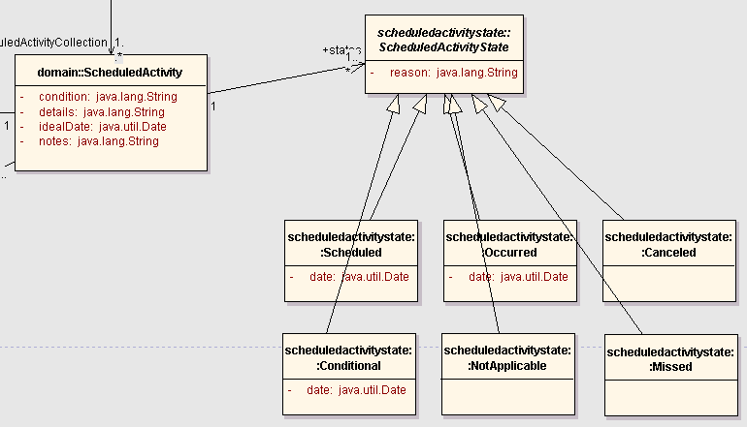
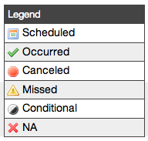
PSC ScheduledActivities
PSC tracks changes in activity state.
PSC allows the user to record a reason for each state change.

Slide 15
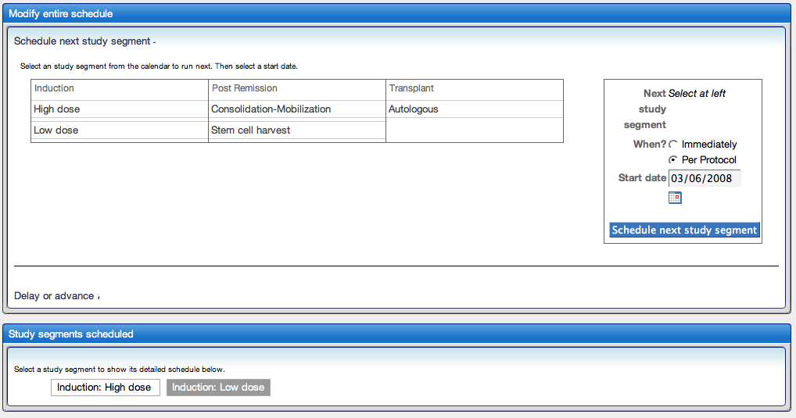
PSC ScheduledCalendar Creation
This screenshot shows how StudySegments are chosen from the PlannedCalendar to create the ScheduledCalendar.
In this example, the ScheduledCalendar has two ScheduledSegments, a High dose and a Low dose of the Induction epoch.

Slide 16
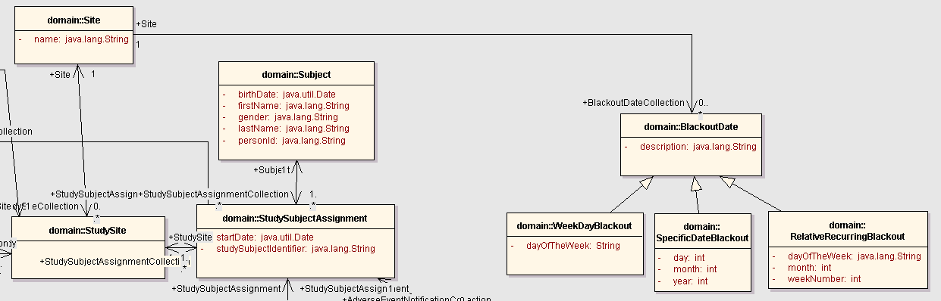
PSC General Clinical Trials Classes
Finally, PSC contains classes which represent the basic data of clinical trials management: Subjects, Studies, Sites, StudySites, StudySubjectAssignments, etc... These should fairly standard across the CTMS WS.
Some additional bits of information we capture about a Site are the days that it is closed. Knowing the BlackoutDates allows PSC to automatically adjust calendars as they are being created so that activities are only scheduled for days on which they can occur.

Slide 17
New Concepts in PSC 2.6
StudySecondaryIdentifier – A collection of identifiers for the study that are alternates to the primary identifier.
Provider – Several classes now have a ‘provider’ attribute to track where the object originated. This was added to differentiate between data that originated locally from data that originated elsewhere (i.e. NCI Enterprise Services).
ActivityProperty – A name-value pair that attaches metadata to all occurrences of the activity. The primary purpose of this class is to allow users to configure references to external systems.
PlannedActivityLabel – A keyword associated with the planned activity that can be used to find the activity and others like it after they become scheduled activities.

Slide 18
For more information:
Available for download and install
  http://gforge.nci.nih.gov/frs/?group_id=31
Vision and Scope document
  https://cabig-kc.nci.nih.gov/CTMS/KC/index.php/PSC_Vision_%26_Scope
UML model
  http://gforge.nci.nih.gov/plugins/scmcvs/cvsweb.php/studycalendar/PhaseII/Construction/Iteration4/PSC_UML-P2-R3.EAP?cvsroot=studycalendar
Architecture Guide
  https://cabig-kc.nci.nih.gov/CTMS/KC/index.php/PSC_Architecture_Guide

